Slide 1
Copyright and consumption

Slide 2
There is no spoon
Léonie Watson

Slide 3
There is no spoon

Slide 4
AI code

Slide 5
Button code
<button type="button" aria-label="Submit form">
Submit
</button>

Slide 6
Better button code
<button>
Accessible name
</button>

Slide 7
AI hallucinations

Slide 8
Image descriptions

Slide 9
Image generation

Slide 10
AI remediation

Slide 11
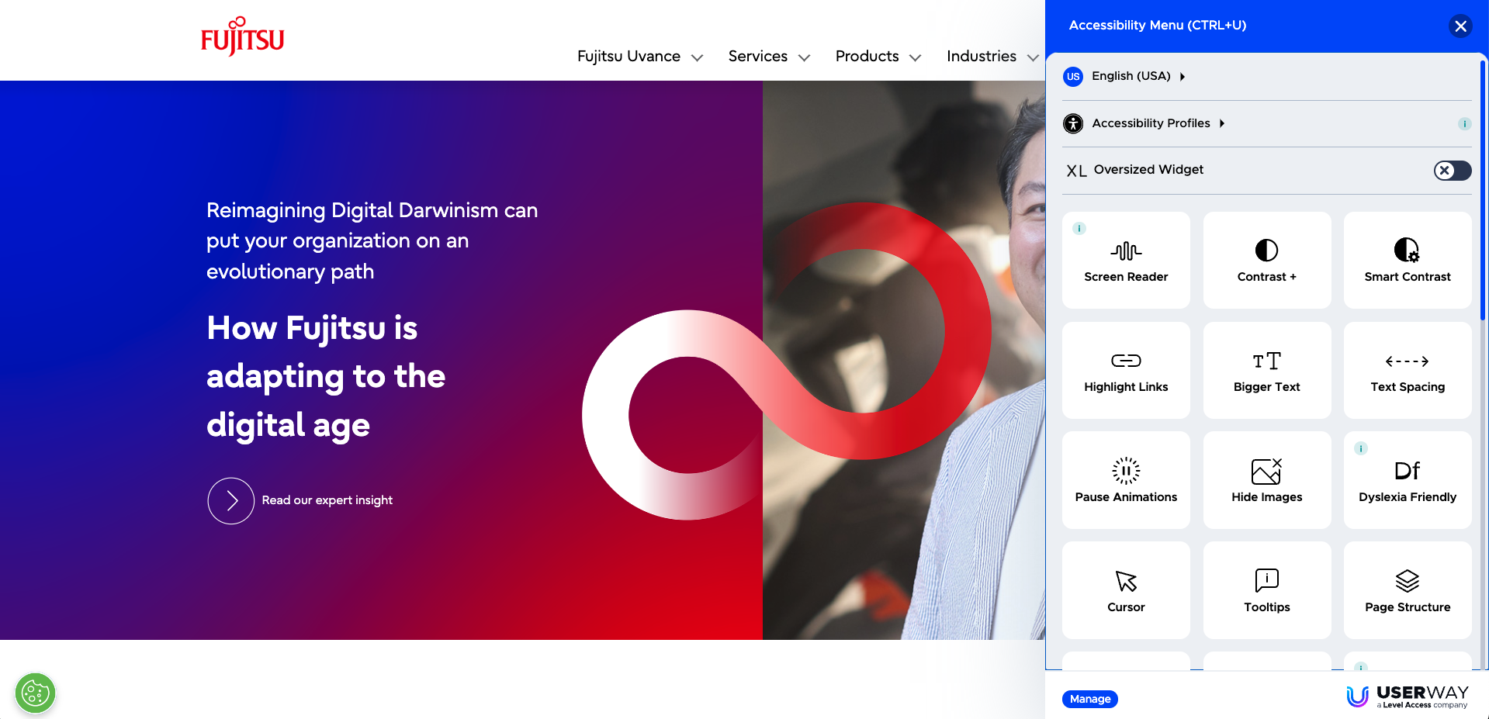
Overlays

Slide 12
Promises

Slide 13
Can’t fix
Notes:
Incorrect heading structure
Missing semantics
Missing event handlers
Missing captions
Keyboard traps

Slide 14
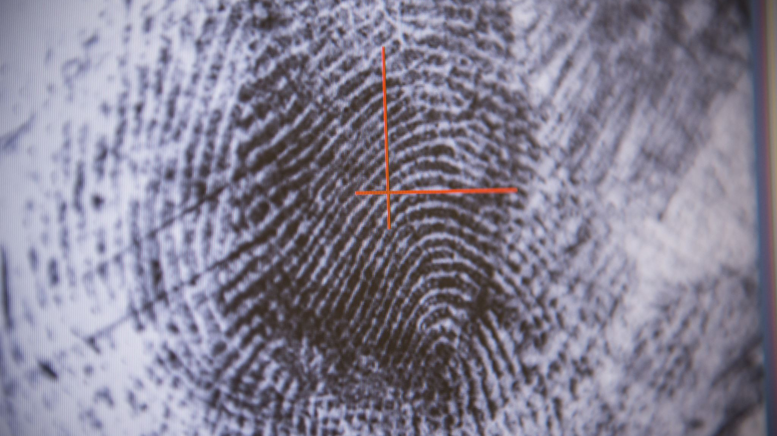
Fingerprinting

Slide 15
Tactics

Slide 16
Results

Slide 17
AI agents

Slide 18
Personalized UI?
Notes:
Accessibility Has Failed: Try Generative UI = Individualized UX:
https://jakobnielsenphd.substack.com/p/accessibility-generative-ui
Nielsen needs to think again:
https://tink.uk/nielsen-needs-to-think-again/

Slide 19
Agentics

Slide 20
Task simplification

Slide 21
AI uses

Slide 22
Image descriptions

Slide 23
Contextual descriptions

Slide 24
Explorable descriptions

Slide 25
Realtime descriptions
fantasai <fantasai@inkedblade.net>, board@w3.org

Slide 26
Wearable descriptions

Slide 27
Video descriptions

Slide 28
New reality

Slide 29
Thank you

