Slide 1
Notes on synthetic speech
Léonie Watson, #GA conf

Slide 2

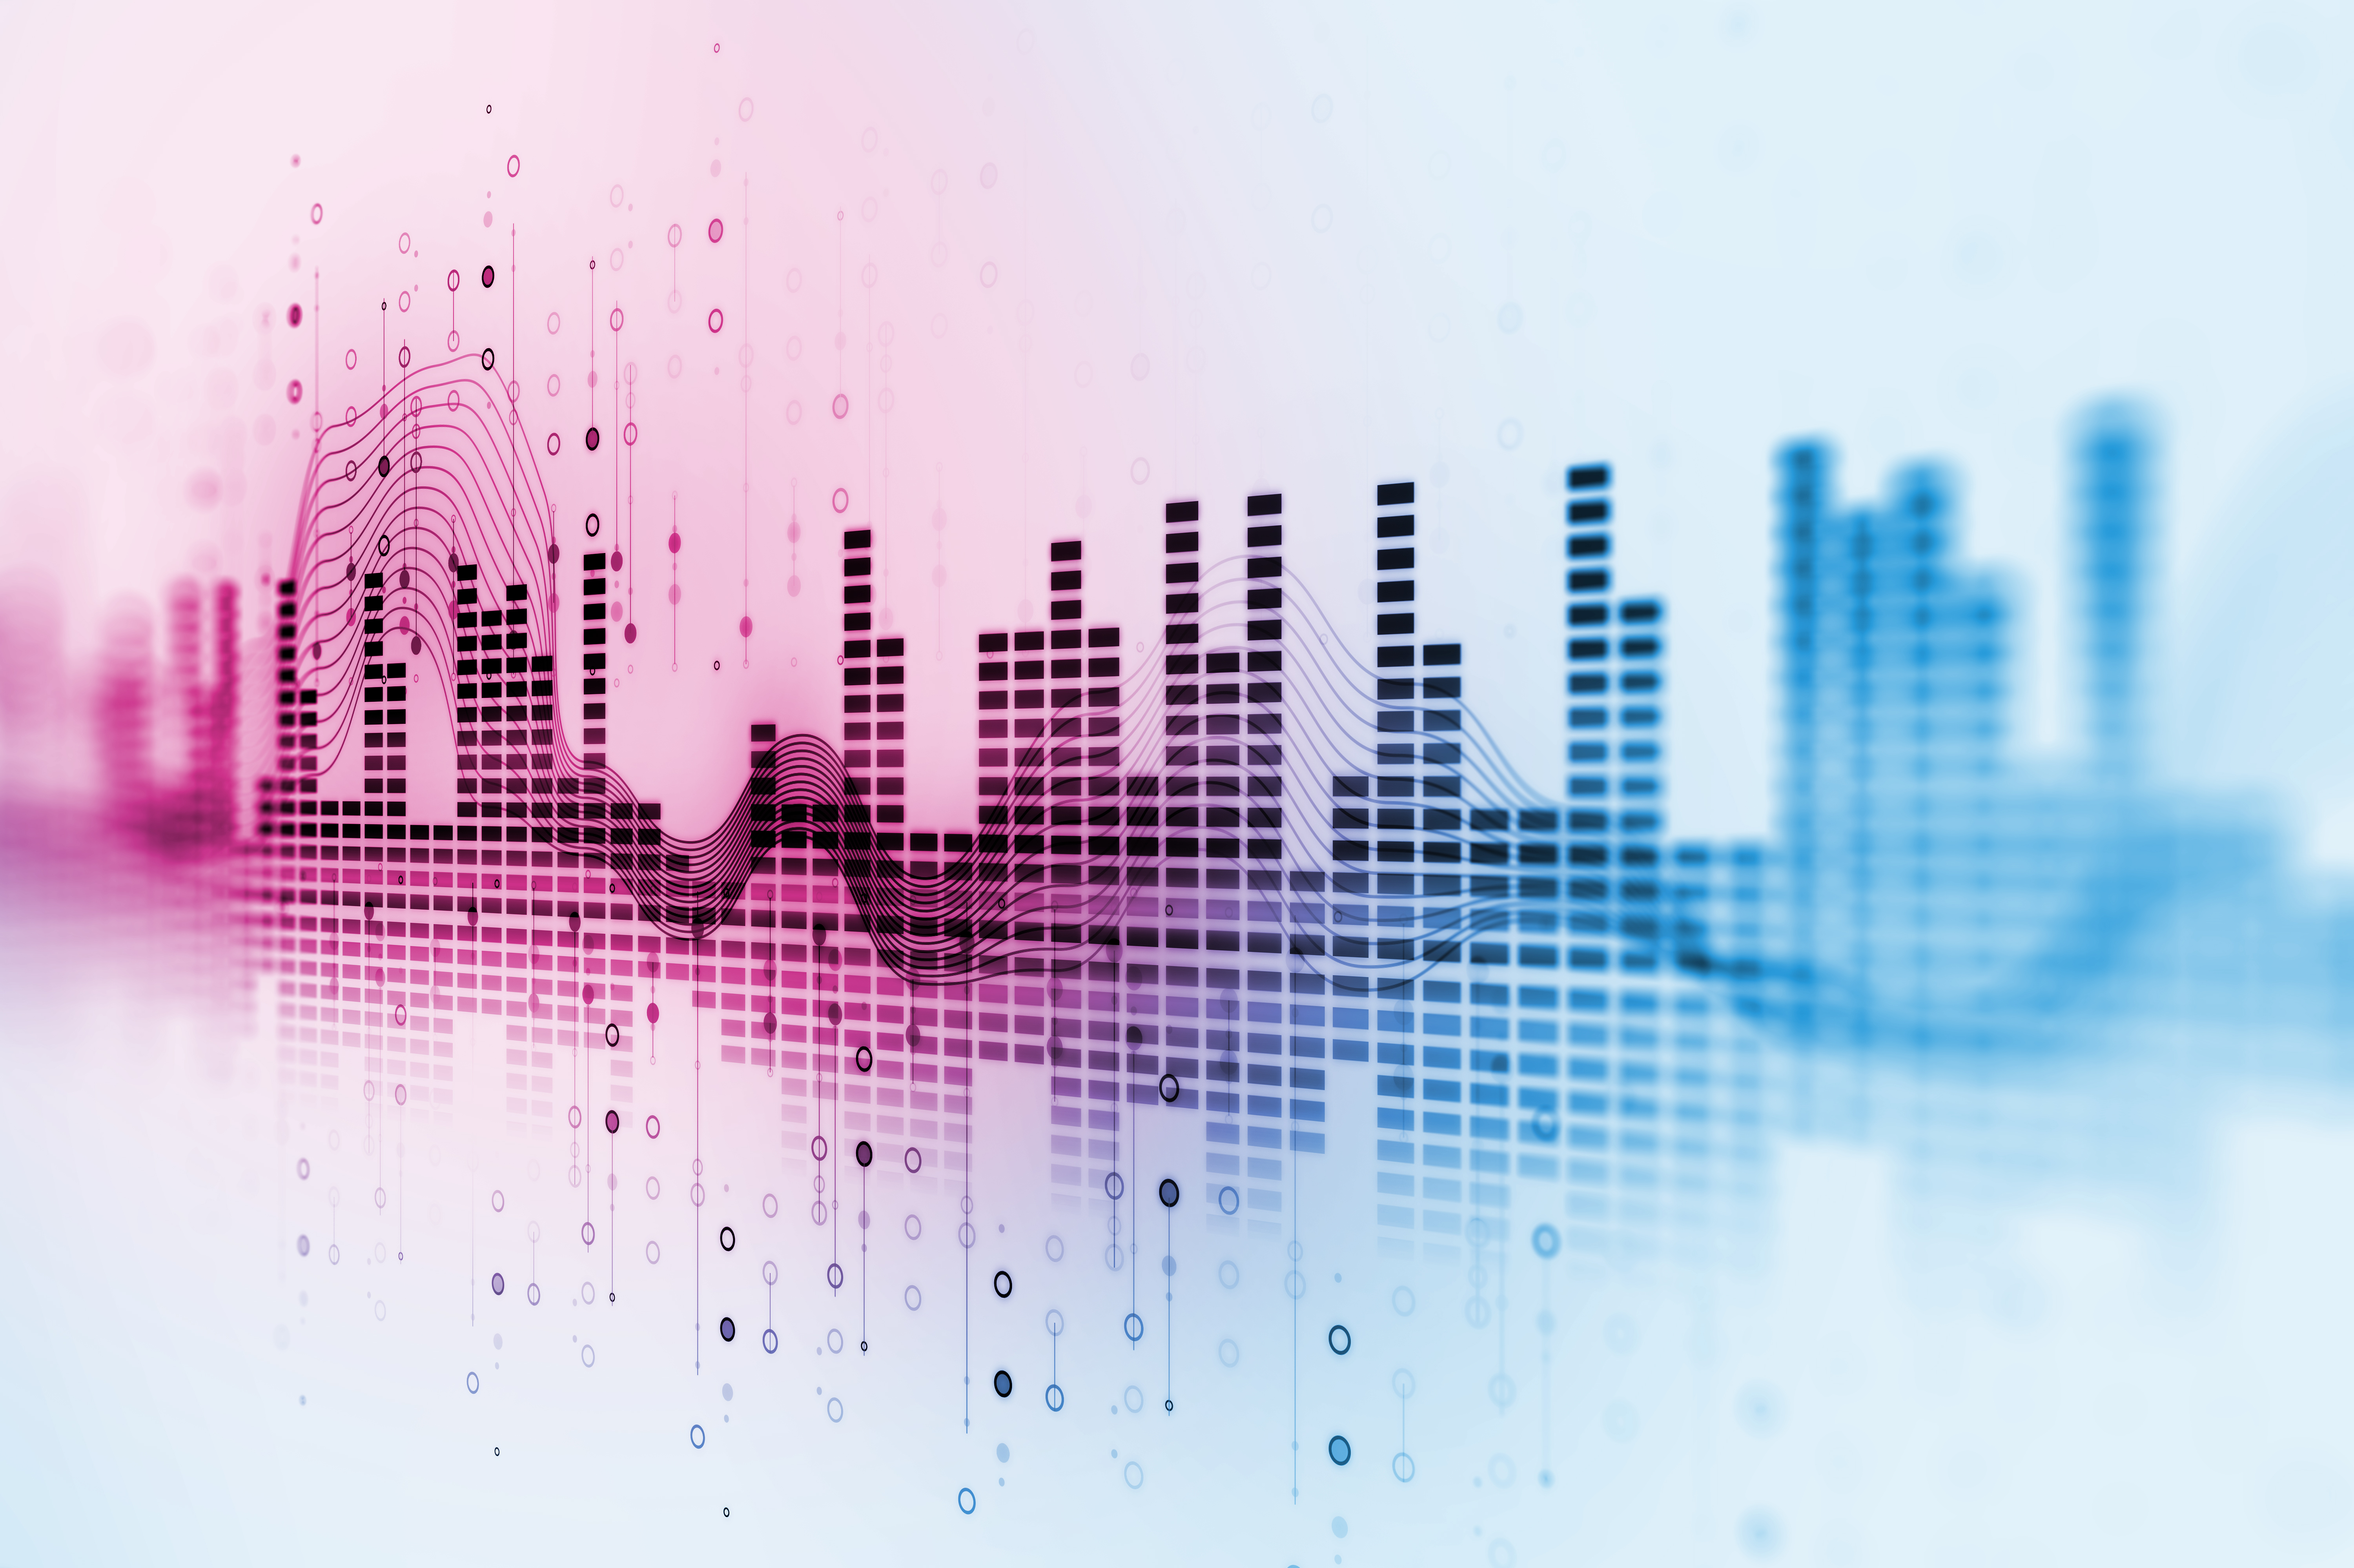
Text To Speech (TTS)

Slide 3
Human speech

Slide 4

Airflow

Slide 5
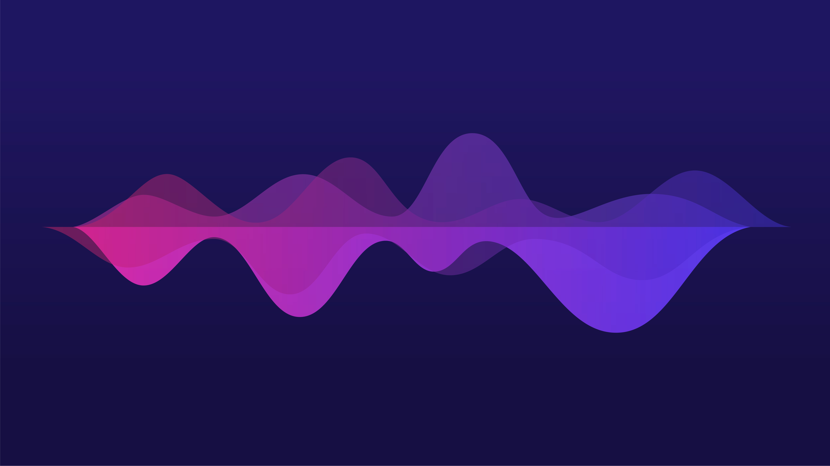
Pitch

Slide 6
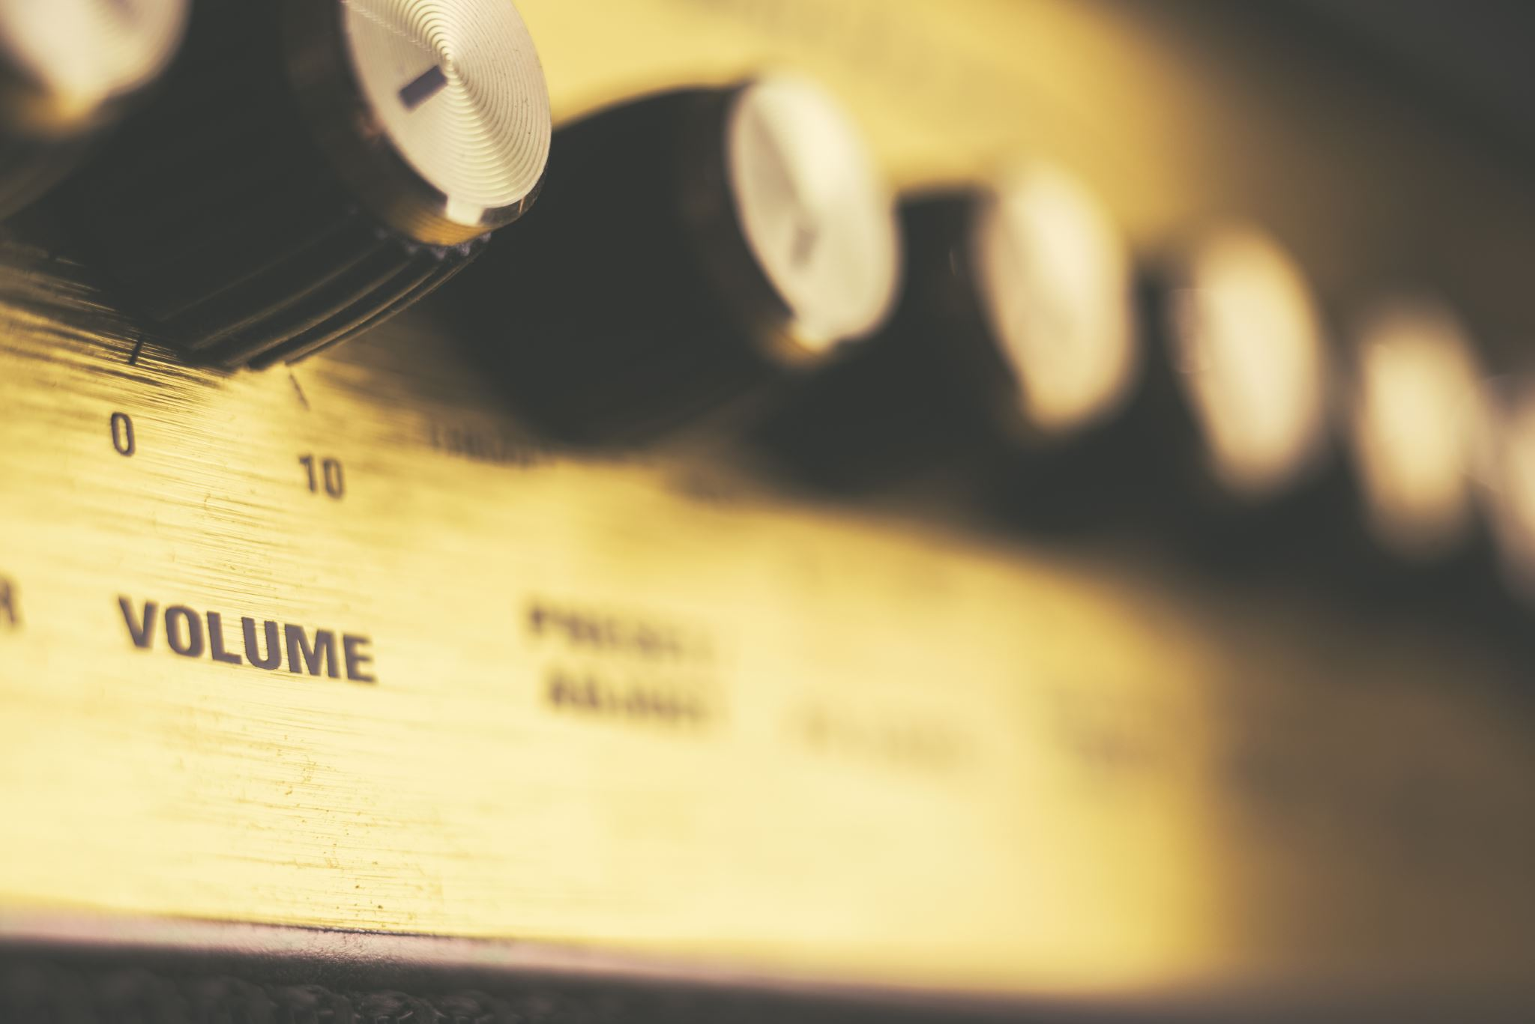
Volume

Slide 7
Synthetic speech

Slide 8

Formant synthesis
Robotic Male Adult Voice:
“Formant synthesis is rule based. The acoustic characters of speech are extracted from a voice recording, then programmed as rules for recreating the voice as digital audio.”

Slide 9
Formant synthesis
Robotic Male Adult Voice: "Hello, this is the voice of Reed.”
Robotic Female Adult Voice: "This is the voice of Shelly”
Robotic Male Child Voice: "This is the voice of Bobby”
Robotic Deep Male Adult Voice: "This is the voice of Rocko”
Robotic High Male Adult Voice: "This is the voice of Glen”
Robotic High Female Adult Voice: "This is the voice of Sandy”
Robotic Elder Female Voice: "This is the voice of Grandma”
Robotic Elder Male Voice: "and this is the voice of Grandpa”

Slide 10
Performance
Robotic Male Adult Voice (standard speaking rate):
“For millions of years humans lived just like the animals, then something happened that unleashed the power of our imagination – we learned to talk.”
Robotic Male Adult Voice (ultra-fast speaking rate):
“For millions of years humans lived just like the animals, then something happened that unleashed the power of our imagination – we learned to talk.”

Slide 11
Concatenative synthesis
Flat Male Adult Voice:
“Concatenative synthesis uses a voice recording that's broken down into tiny chunks. The chunks are then reconstructed from a database to form the synthesized speech.”

Slide 12
Parametric synthesis
Realistic Male Adult Voice:
“Parametric synthesis uses a statistical model. The parameters of speech are extracted from a voice recording, then Hidden Markov Models (HMM) modify the parameters based on the text to be spoken.”
Notes:
Traditional TTS uses rule-based or statistical techniques, dependent on pre-defined linguistic and acoustic models, with a two step process:
1. Linguistic analysis
2. Acoustic production

Slide 13
Neural synthesis
Almost Human Male Adult Voice:
“Neural TTS uses artificial neural networks trained on huge amounts of voice data. The neural networks learn the relationships between text and speech, and the result is voices that sound very close to human speech.
Notes:
Neural (NTTS) uses a single end-to-end process that's trained on vast amounts of speech data.

Slide 14
Clones
Almost Léonie’s Voice:
“Neural TTS can transfer the prosodic characteristics of one voice to another, making it possible to synthesize speech in the voice of a particular speaker (with comparatively little individual training data).”

Slide 15
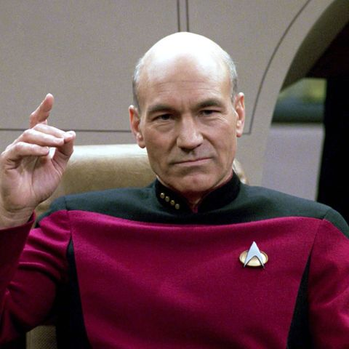
Jean Luc Picard

Slide 16
In the cloud

Slide 17

Privacy

Slide 18
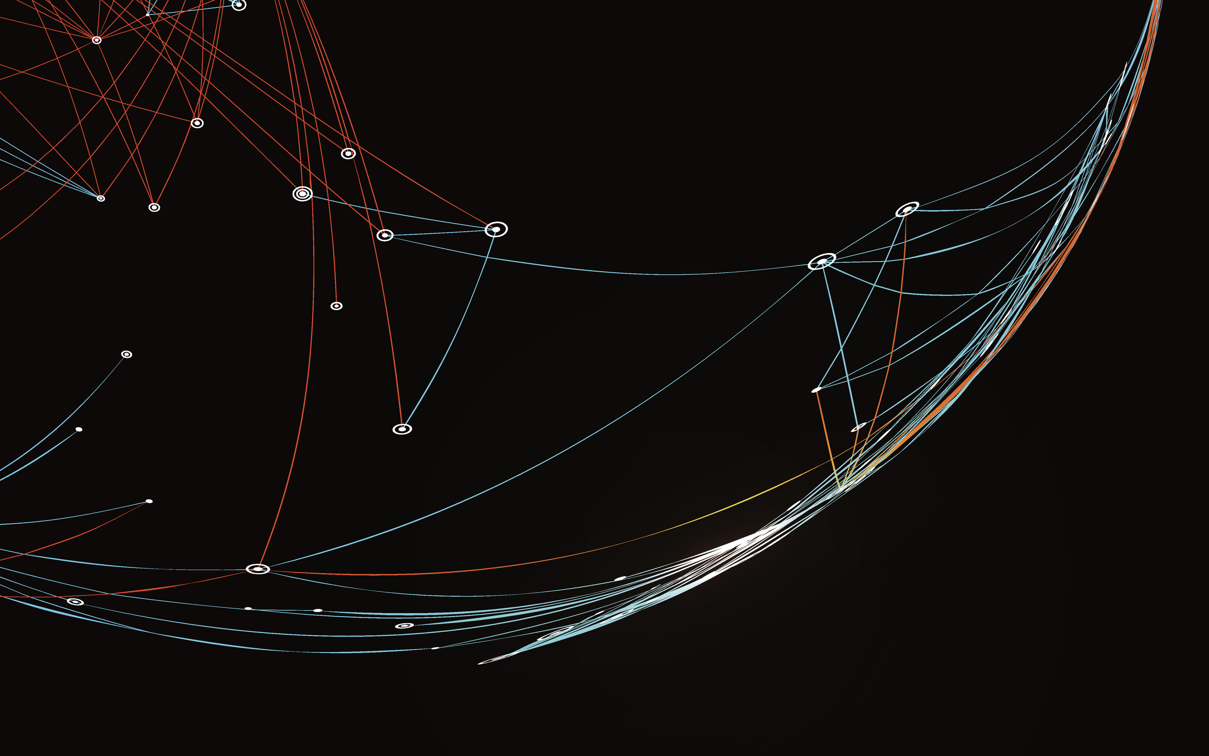
Network

Slide 19
On device

Slide 20

Microsoft

Slide 21
In game

Slide 22
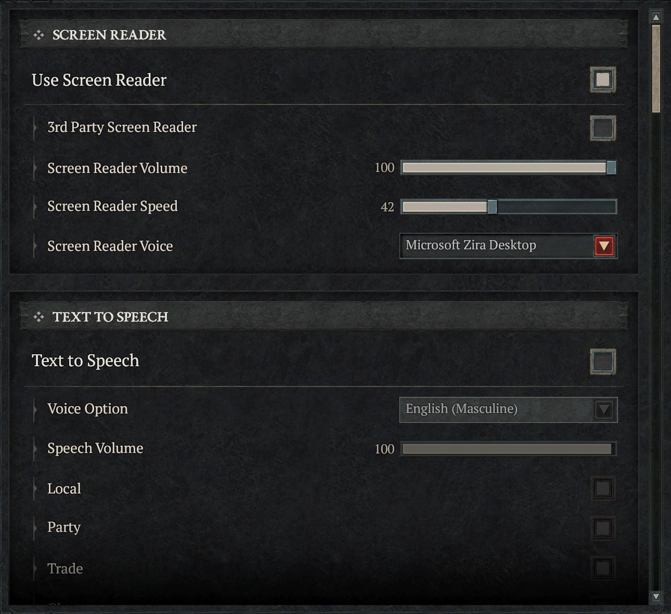
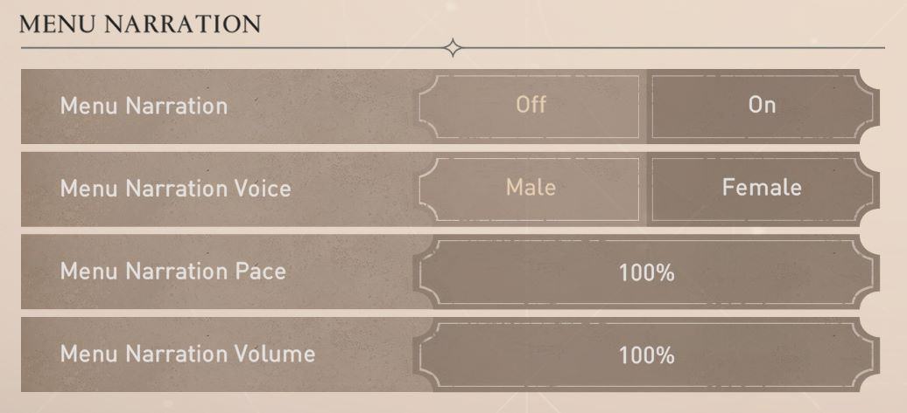
Customisable

Slide 23
Thank you
Léonie Watson, #GA conf

