Slide 1
Copyright and consumption

Slide 2
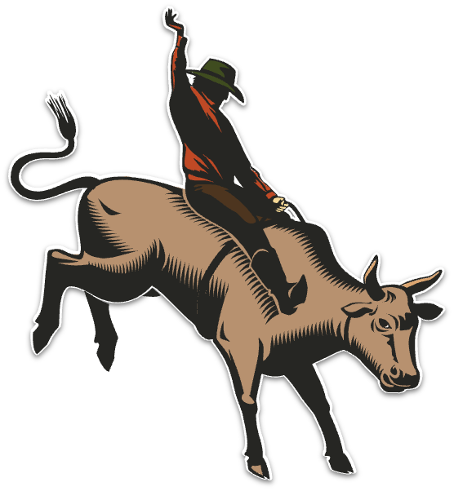
AI and Accessibility:
the Good,
the Bad,
and the Bollocks
Léonie Watson

Slide 3
Never mind

Slide 4
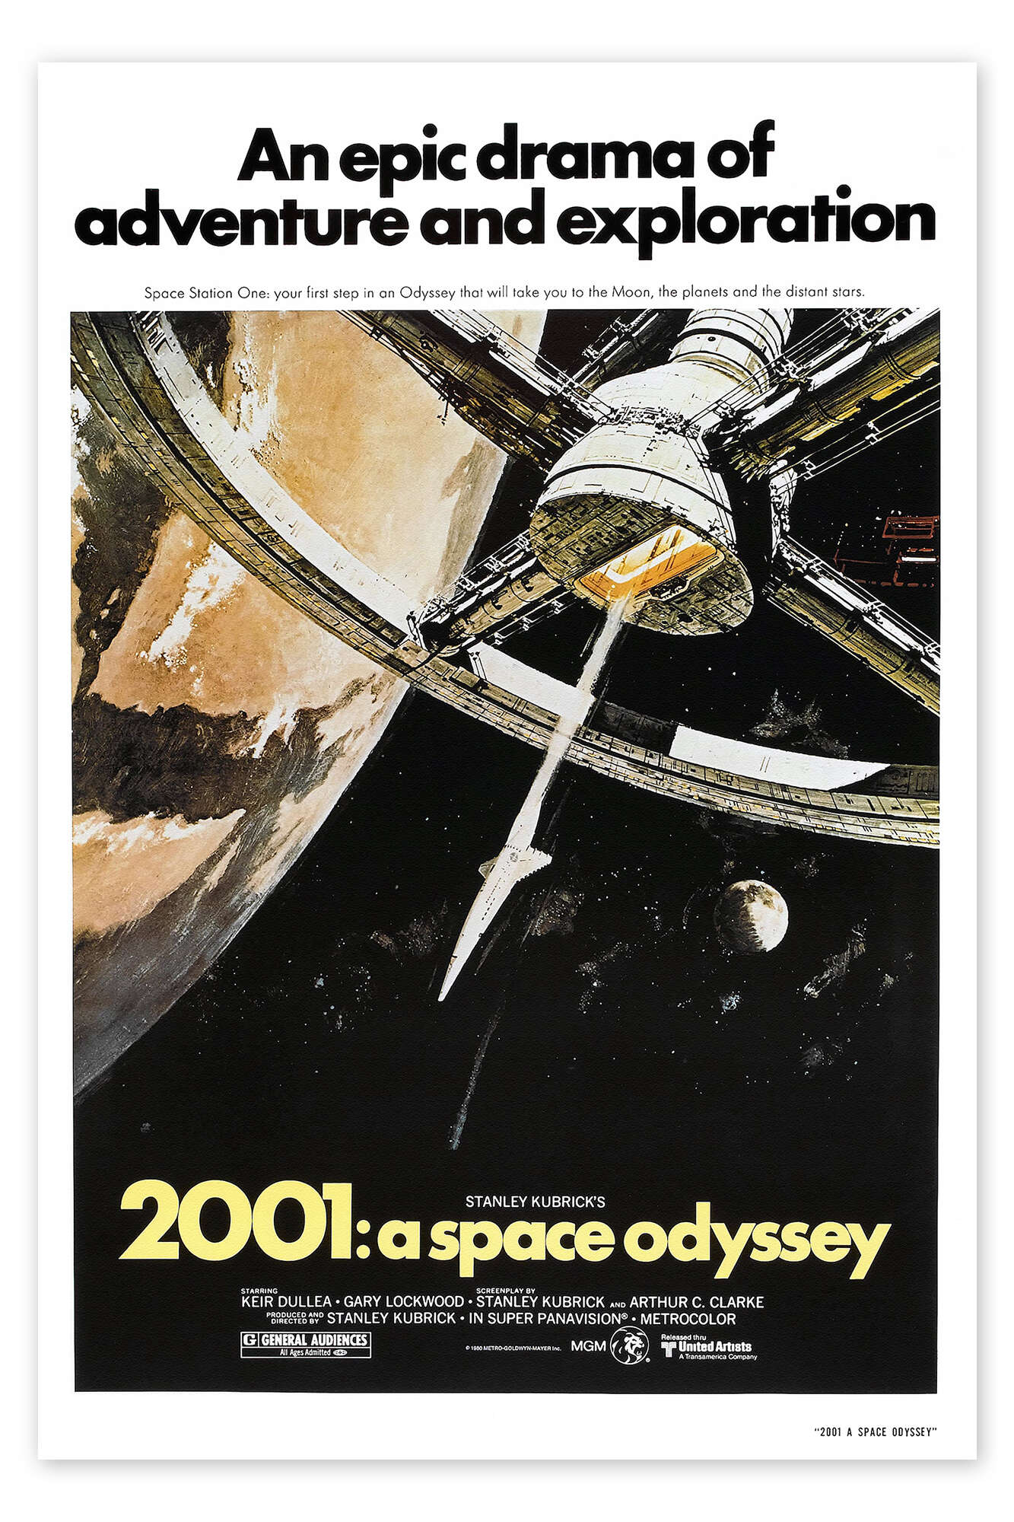
General AI

Slide 5
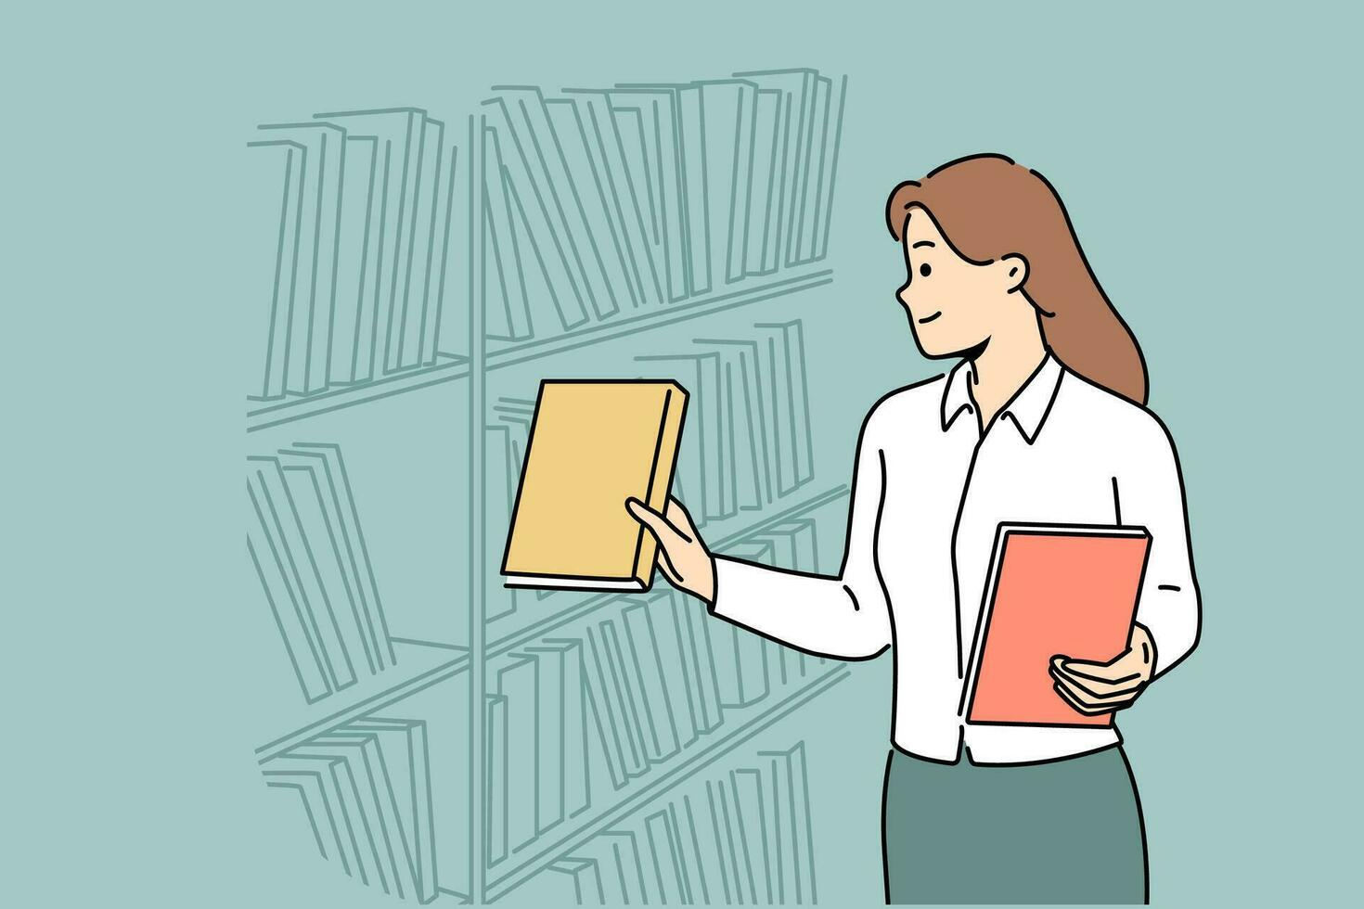
Discriminative AI

Slide 6
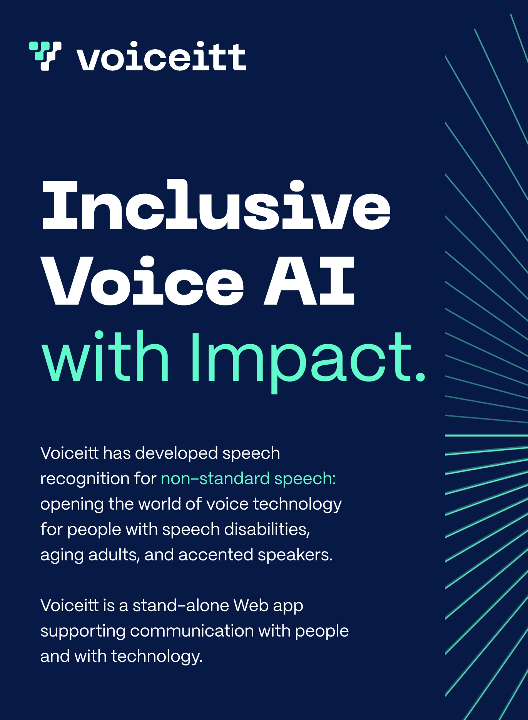
Speech recognition

Slide 7
Object recognition

Slide 8
Face recognition

Slide 9
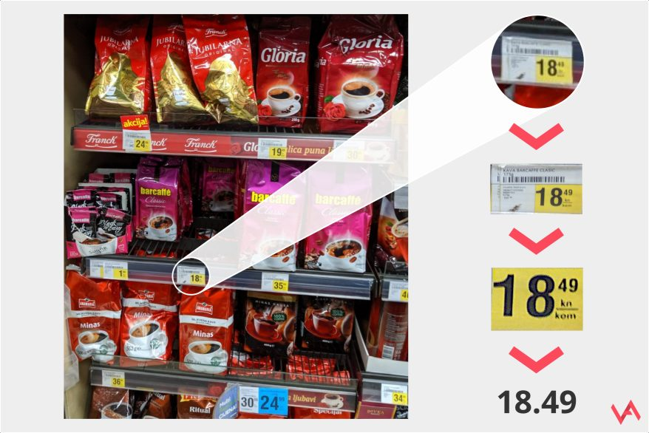
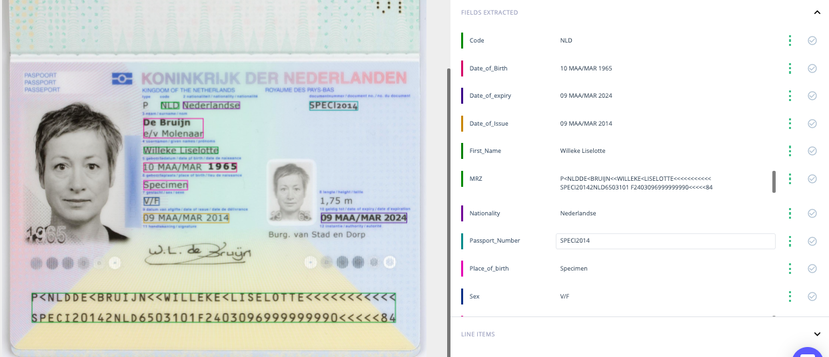
Character recognition

Slide 10
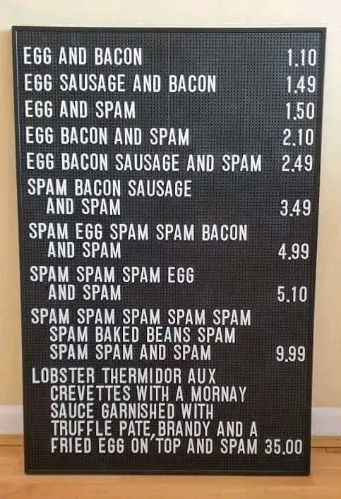
Pattern recognition

Slide 11
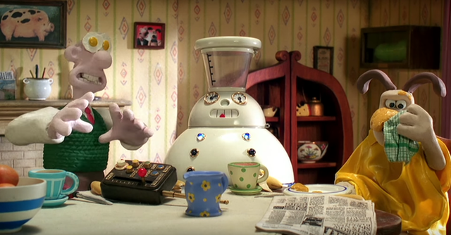
Generative AI

Slide 12
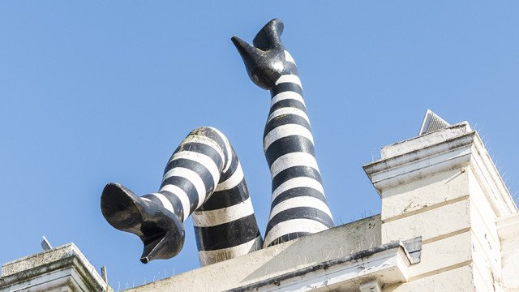
Text generation

Slide 13
Video description

Slide 14
Realtime description
fantasai <fantasai@inkedblade.net>, board@w3.org

Slide 15
Wearable

Slide 16
Text + speech generation
https://easyspeak-aac.com

Slide 17
Speech generation

Slide 18
Pattern recognition + speech generation

Slide 19
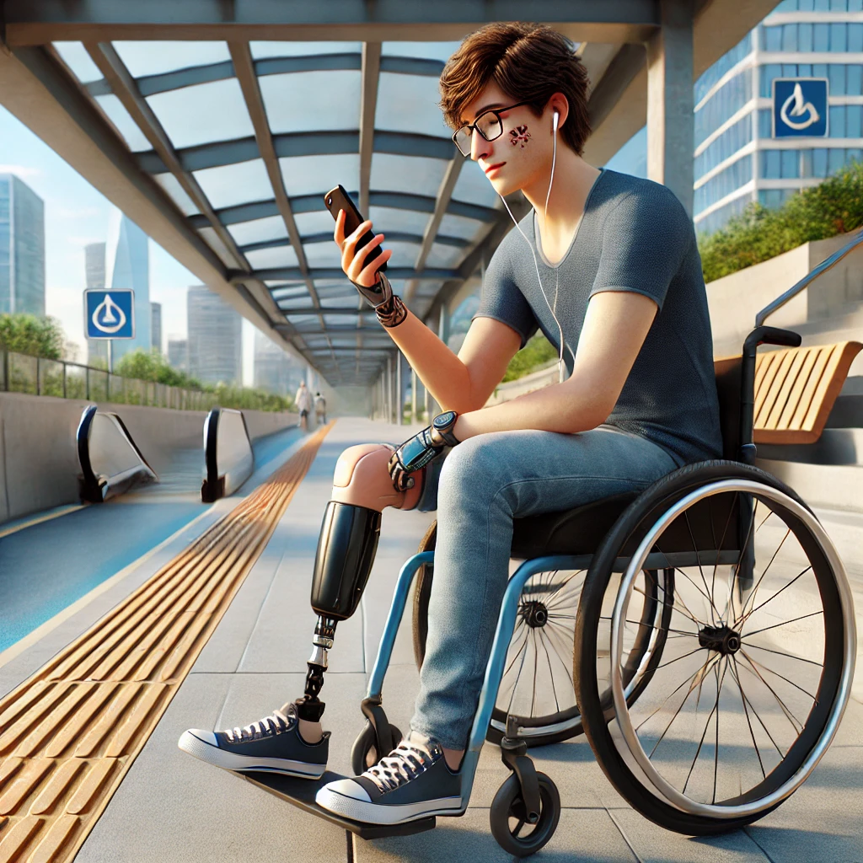
Image generation

Slide 20
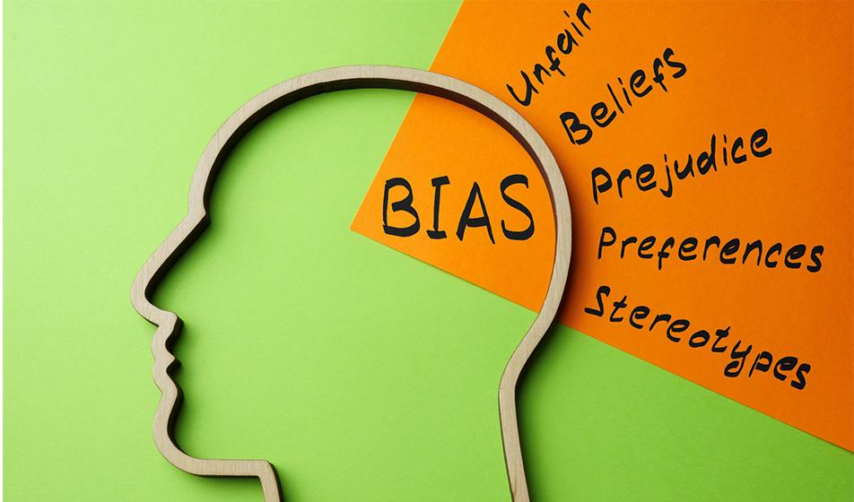
Bias

Slide 21
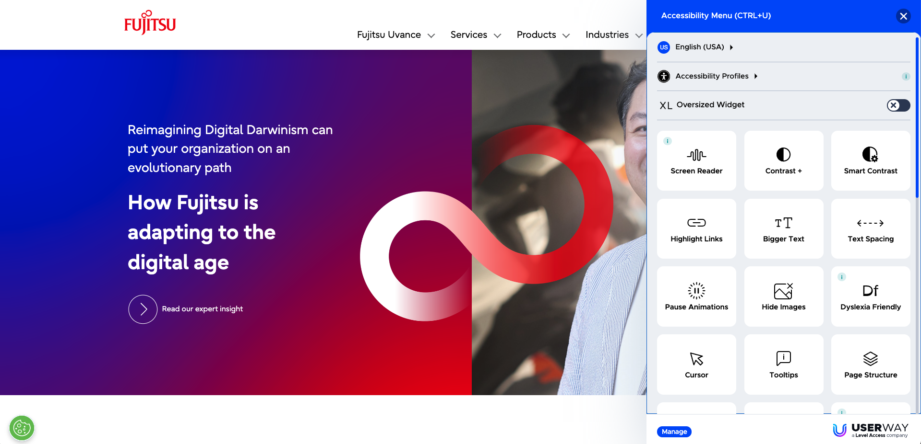
Overlays

Slide 22
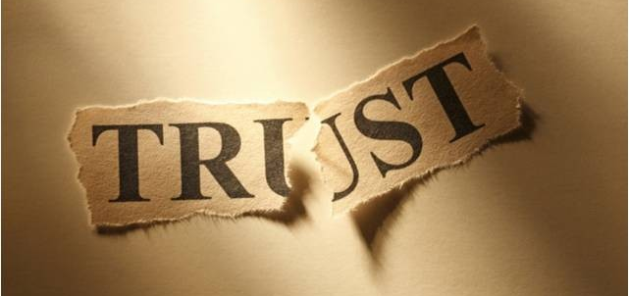
Promises

Slide 23
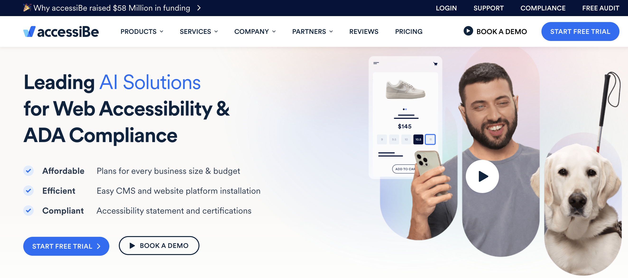
AccessiBe

Slide 24
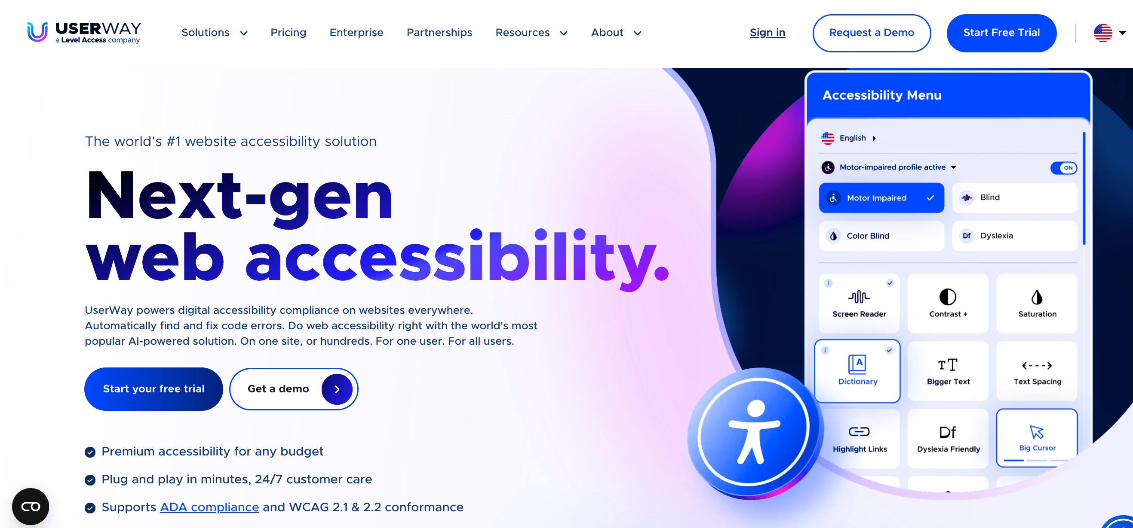
UserWay

Slide 25
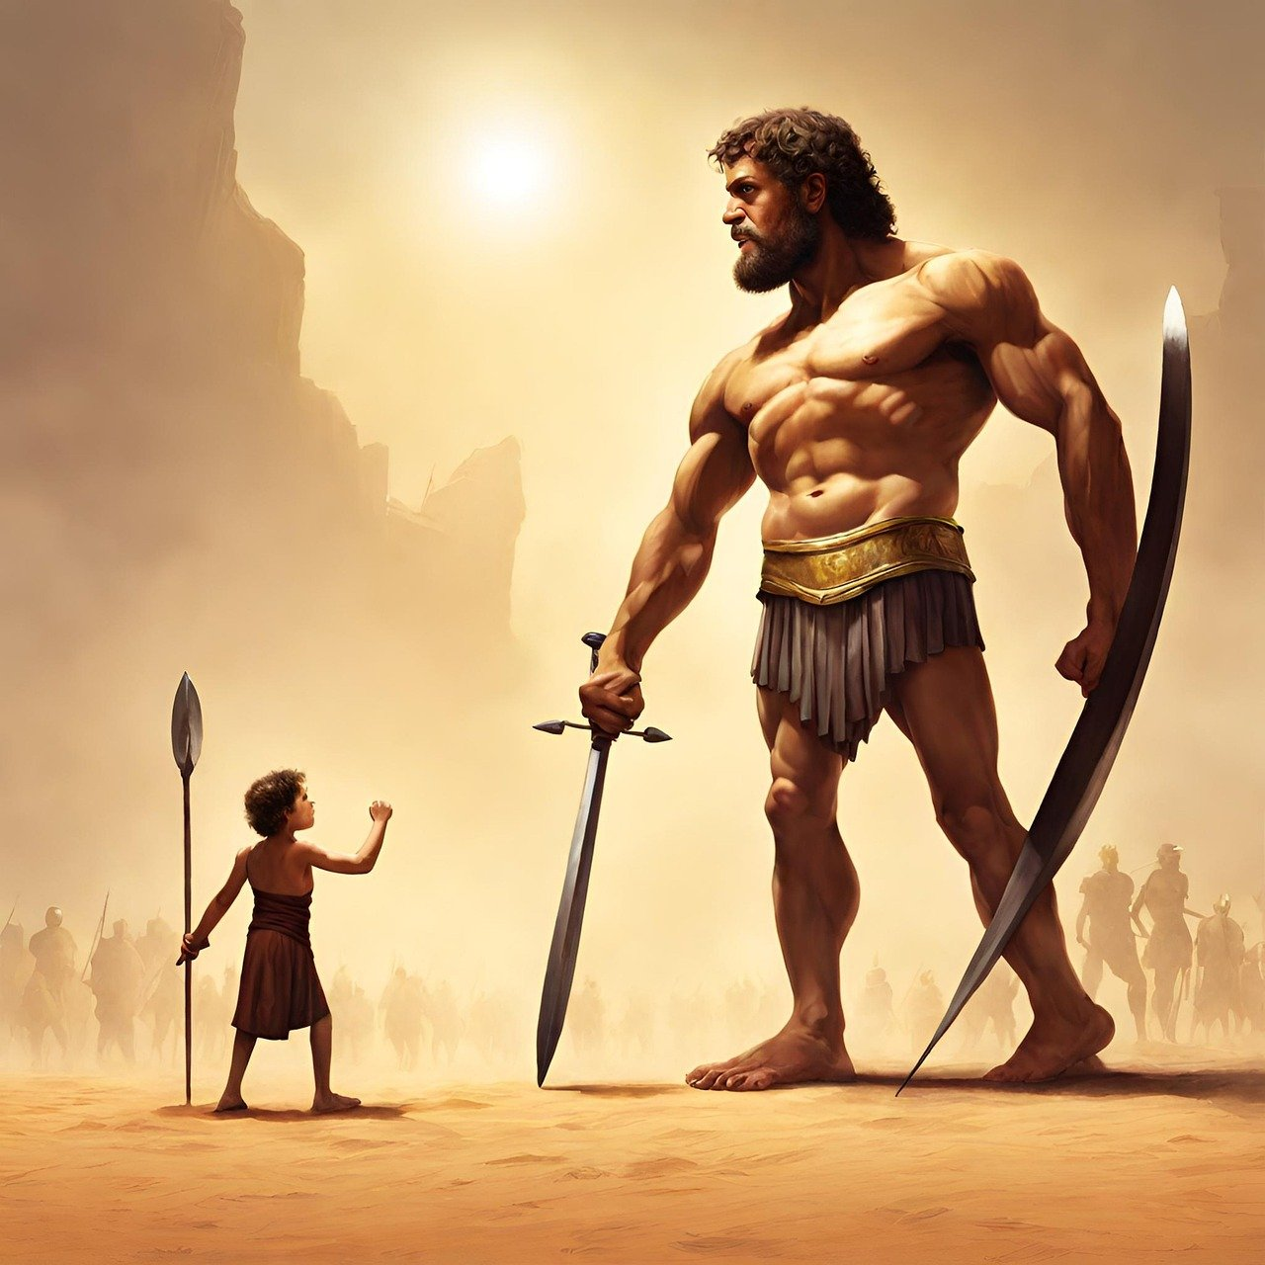
Tactics

Slide 26
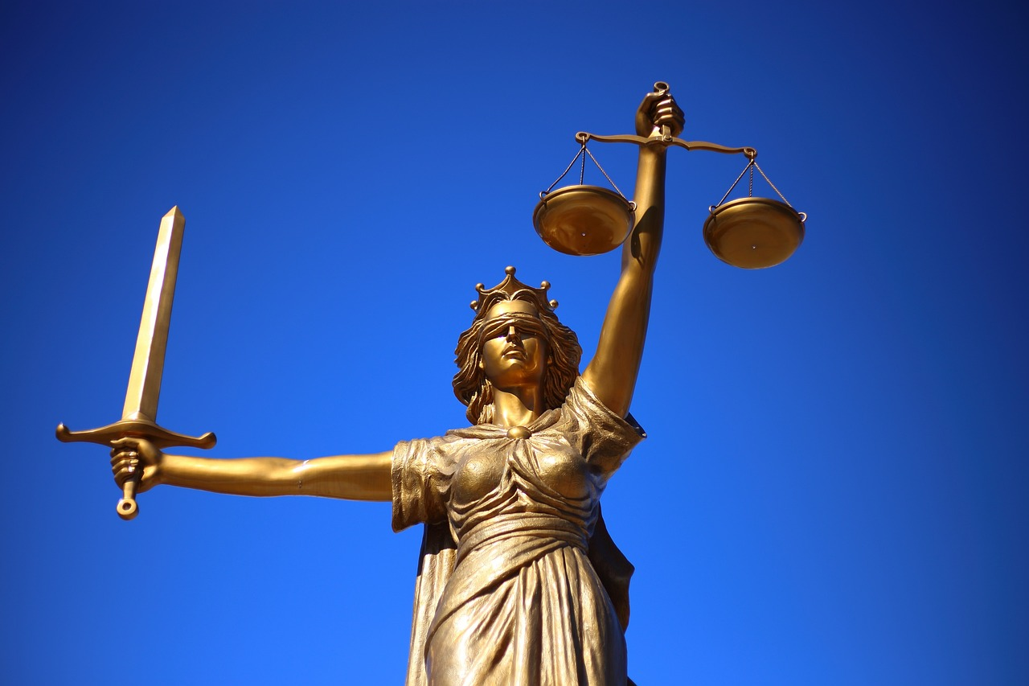
Results

Slide 27
Code generation
*** Shortened blog post video ***

Slide 28
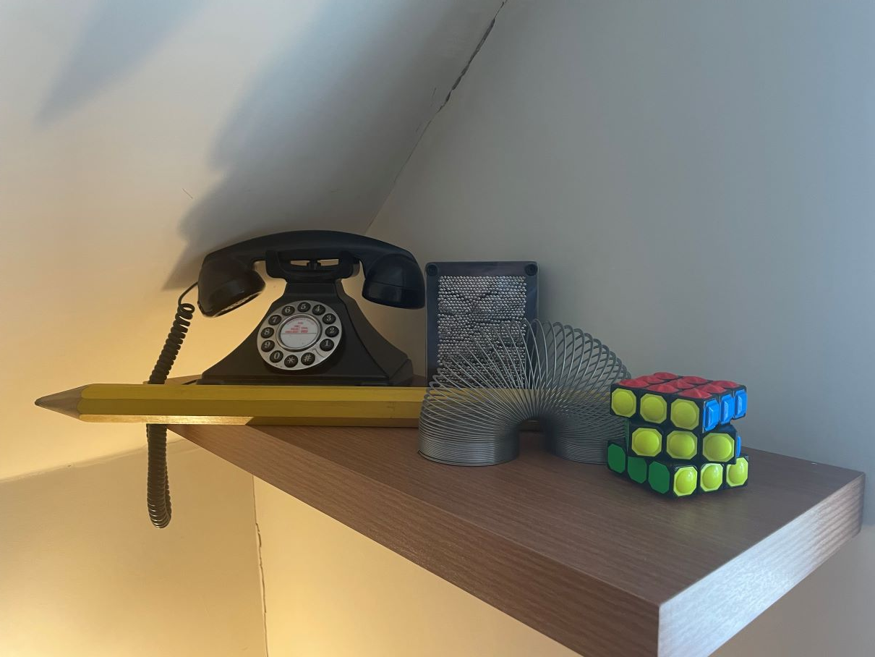
Hallucinations

Slide 29
Thank you

