Slide 1
Accessibility: the land that time to interactive forgot
Performance.now

Slide 2
Web performance
The objective measurement and perceived experience of the time it takes a website to load and become interactive

Slide 3
Critical Rendering Path (CRP)
Paint
DOM
CSS Object Model
Render Tree
Layout

Slide 4
Paint
Paint

Slide 5
Paint
Paint

Slide 6
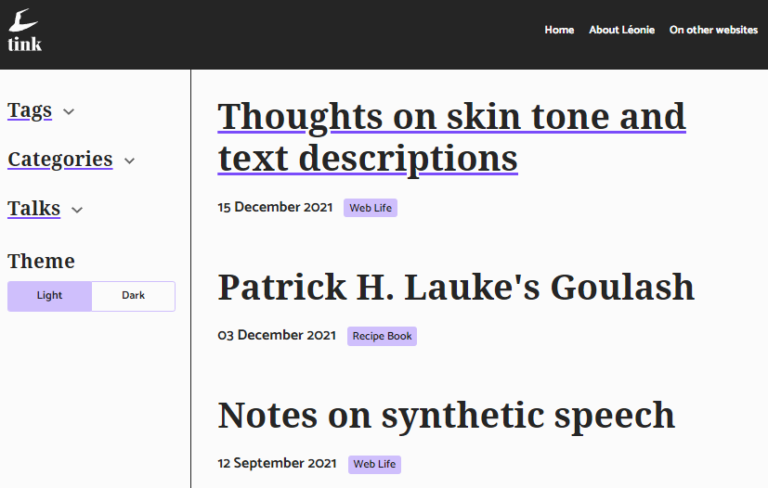
Paint
Paint

Slide 7
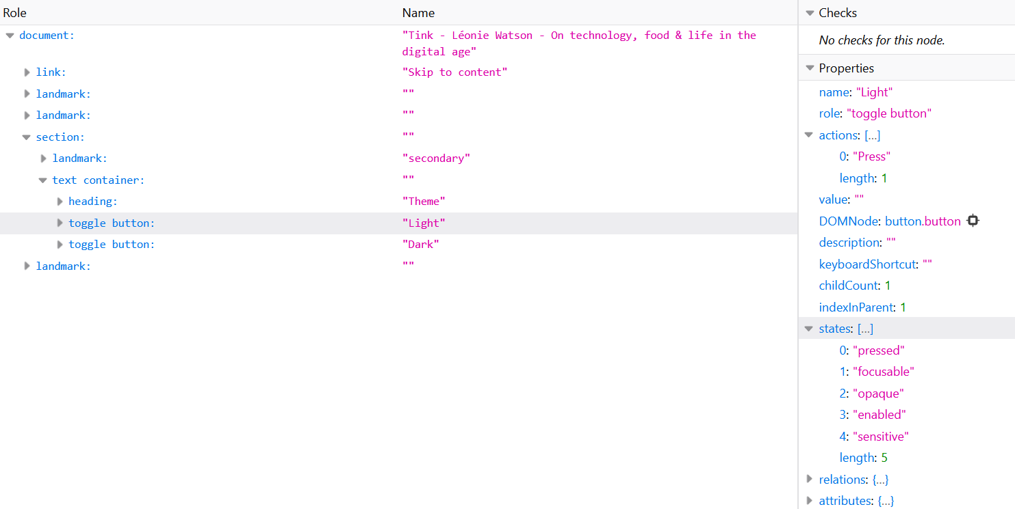
Accessibility tree

Slide 8
Semantics
HTML elements and attributes have implicit semantics

Slide 9
Role
An element’s role describes its purpose

Slide 10
The <button> element
<button></button>

Slide 11
Name
An element’s accessible name identifies it

Slide 12
The <button> element
<button>Show password</button>

Slide 13
State
An element’s state describes its current condition

Slide 14
The aria-pressed attribute
<button aria-pressed=“true“>Show password</button>

Slide 15
Wait for it…

Slide 16
Platform accessibility API
MSAA + Iaccessible
MSAA + IAccessible2
NSAccessibility Protocol
AT-SPI
UIAutomation

Slide 17
Single process model

Slide 18
Multi-process model
Application
Content

Slide 19
In process communication
Application
Content
Screen Reader

Slide 20
Out of process communication
Application
Content
Screen Reader

Slide 21
Internet Explorer -7
Application / Content
Screen Reader

Slide 22
Internet Explorer: accessibility performance
Fast Time To Interactive (TTI)
Good subsequent performance
Prone to instability

Slide 23
Chrome and Firefox
Application
Content
Screen Reader

Slide 24
Chrome: initial approach
Proxied all API calls

Slide 25
Chrome: current approach
Caches the whole accessibility tree

Slide 26
Chrome: accessibility performance
Possible slow TTI
Good subsequent performance

Slide 27
Firefox: current approach
Proxies API calls with intelligent caching

Slide 28
Firefox: accessibility performance
OK TTI
OK subsequent performance

Slide 29
Firefox: future approach
Caches the whole accessibility tree
Enable accessibilityCache in Firefox Nightly

Slide 30
Safari
Application
Content
Screen Reader

Slide 31
Safari: accessibility performance
Fast TTI
Good subsequent performance

Slide 32
Accessibility rendering path
DOM
CSS Object Model
Render Tree
Layout
Acc Tree

Slide 33
Rendering the accessibility tree
DOM
CSS Object Model
Layout
Acc Tree

Slide 34
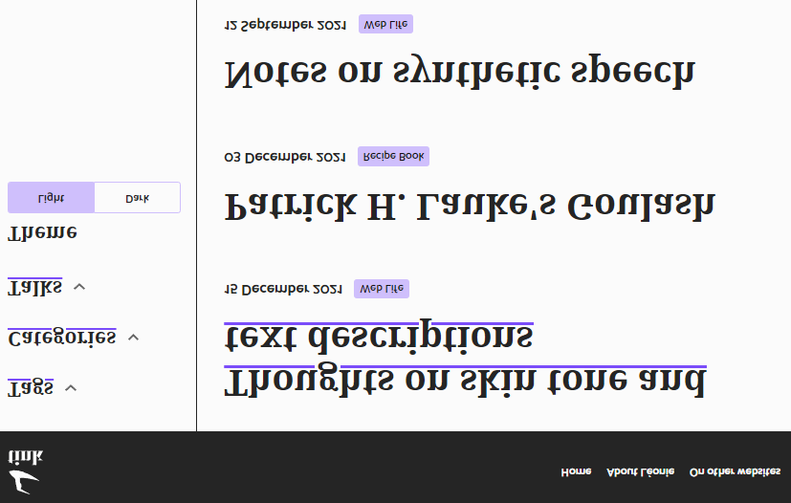
Virtual buffer

Slide 35
Heading navigation

Slide 36
Perceived experience
Little things matter!

Slide 37
Objective measurements
https://github.com/GoogleChrome/lighthouse/issues/11049

Slide 38
Practical steps

Slide 39
Thank you
In particular to Glen Gordon, Jamie Teh, and Jeff Petty

