Slide 1
Bag of spanners
Joy of Coding @LeonieWatson

Slide 2
Everyone’s responsibility

Slide 3
Part of your toolkit

Slide 4
Cause and effect

Slide 5
Mechanics

Slide 6
Platform accessibility API
MSAA + Iaccessible
MSAA + IAccessible2
NSAccessibility Protocol
AT-SPI
UIAutomation

Slide 7
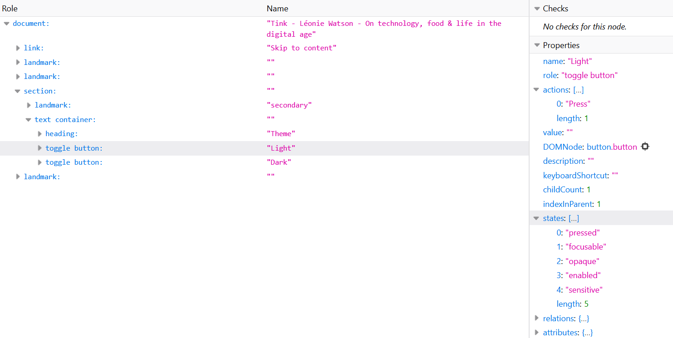
Accessibility tree

Slide 8
Semantics

Slide 9
Implicit semantics
HTML elements and attributes have implied semantics

Slide 10
Explicit semantics
Explicit semantics can be applied using ARIA

Slide 11
Role
An element’s role describes its purpose

Slide 12
The <button> element
<button></button>

Slide 13
Name
An element’s accessible name identifies it

Slide 14
The <button> element
<button>Show password</button>

Slide 15
State
An element’s state describes its current condition

Slide 16
The aria-pressed attribute
<button aria-pressed=“true“>Show password</button>

Slide 17
Nav
<nav>…</nav>

Slide 18
Nav
<nav aria-label=“Website“>…</nav>

Slide 19
Lists
<ul>
<li>Role</li>
<li>Name</li>
<li>State</li>
</ul>

Slide 20
Navigation
<nav aria-label=“Website“>
<ul>
<li><a href=“/“>Home</a></li>
<li><a href=“/about/“>About</a></li>
…
</ul>
</nav>

Slide 21
Navigation
<nav aria-label=“Website“>
<ul>
<li><a aria-current=“true” href=“/“>Home</a></li>
<li><a href=“/about/“>About</a></li>
…
</ul>
</nav>

Slide 22
Radio buttons
<label for="r1">
<input type="radio" id="r1" name=“colour">
Purple</label>
<label for="r2">
<input type="radio" id="r2" name=“colour">
Red</label>

Slide 23
Radio groups
<fieldset>
<legend>Choose a colour</legend>
<label for="r1">
<input type="radio" id="r1" name=“colour">
Purple</label>
<label for="r2">
<input type="radio" id="r2" name=“colour">
Red</label>
</fieldset>

Slide 24
Data tables
<table>
<caption>Average daily tea and coffee consumption</caption>
<tr>
<th>Person</th><th>Coffee</th><th>Tea</th>
</tr>
<tr>
<th>Njoki</th><td>5 cups</td><td>0 cups</td>
</tr>
<tr>
<th>Iesha</th><td>1 cup</td><td>2 cups</td>
</tr>
<tr>
<th>Léonie</th><td>0 cups</td><td>25 cups</td>
</tr>
</table>

Slide 25
Data table demo

Slide 26
Interaction

Slide 27
Implicit keyboard support
HTML interactives have implicit keyboard support

Slide 28
Explicit keyboard support
Explicit keyboard support must be provided for custom HTML

Slide 29
The <button> element
<button id="button">Play</button>
button = document.querySelector("#button");
button.addEventListener("click", playThis);

Slide 30
The <a> element
<a href="#" id="button">Play</a>
button = documentQuerySelector("#button");
button.addEventListener("click", playThis);
button.addEventListener("keydown", function(e) {
if (e.keyCode ==13) {
playThis();
}
});

Slide 31
The <a> element
<a id="button">Play</a>
button = documentQuerySelector("#button");
button.addEventListener("click", playThis);
button.addEventListener("keydown", function(e) {
if (e.keyCode == 13 || e.keyCode == 32) { playThis();
}
});
Button.setAttribute("tabindex", "0");

Slide 32
The <a> element
<a id="button">Play</a>
button = documentQuerySelector("#button");
button.addEventListener("click", playThis);
button.addEventListener("keydown", function(e) {
if (e.keyCode ==13 || e.keyCode ==32) { playThis();
}
});
button.setAttribute("tabindex","0");
button.setAttribute("role", "button");

Slide 33
Construction

Slide 34
Menubar: Basic HTML
<ul>
<li>
<a href="#">Categories</a>
<ul>
<li> <a href="code.html">Code things</a> </li>
<li> <a href="life.html">Web life</a> </li>
...
</ul>
</li>
...
</ul>

Slide 35
Menubar: Roles
<ul role="menubar">
<li role="none">
<a role="menuitem" href=“#">Categories</a>
<ul role="menu">
<li role="none">
<a role="menuitem" href="code.html">Code things</a>
</li>
<li role="none">
<a role="menuitem" href="life.html">Web life</a>
</li>
...

Slide 36
Menubar: Names
<ul>
<li role="none">
<a role="menuitem" href="#">Categories</a>
<ul role="menu" aria-label="Categories">
<li role="none">
<a role="menuitem" href="code.html">Code things</a>
</li>
<li role="none">
<a role="menuitem" href="life.html">Web life</a>
</li>
...

Slide 37
Menubar: States
<ul>
<li role="none">
<a role="menuitem" aria-expanded="false" href="#">Categories</a>
<ul role="menu" aria-label="Categories">
<li role="none">
<a role="menuitem" href="code.html">Code things</a>
</li>
<li role="none">
<a role="menuitem" href="life.html">Web life</a>
</li>
...

Slide 38
Menubar demo

Slide 39
Keyboard commands
Enter/Space
Opens/closes the menu
Up/Down/Left/Right
Cycles through the menus
Escape
Closes the open menu and returns focus to the parent menu

Slide 40
Menubar demo

Slide 41
Mechanics Semantics Interaction Construction

Slide 42
Thank you!
Joy of Coding @LeonieWatson

