Slide 1
What You See Is What I Get
Web Directions AAA

Slide 2
Platforms

Slide 3
Windows
91%

Slide 4
MacOS
6.5%

Slide 5
Linux
1%

Slide 6
Screen readers

Slide 7
JAWS
54%

Slide 8
NVDA
31%

Slide 9
VoiceOver
6.5%

Slide 10
Components

Slide 11
Screen reader

Slide 12
Keyboard commands
Keyboard users have a limited set of commands available
Screen reader users have lots more

Slide 13
Modifier keys
JAWS, NVDA, Narrator:
Insert
Capslock
VoiceOver:
Control + Option
Capslock

Slide 14
Keyboard commands
For reading text by character, word, or line

Slide 15
Keyboard commands
For navigating by elements like:
Headings
Landmarks
Lists and listitems
Tables
Graphics
Links
Form fields and controls

Slide 16
Text To Speech engine

Slide 17
Voices
Each TTS engine includes a choice of different voices

Slide 18
Accents
TTS voices can have different accents

Slide 19
Rate
“For millions of years, humans lived just like the animals. Then something happened that unleashed the power of our imagination. We learned to talk.

Slide 20
Punctuation
Piglet sidled up to Pooh from behind.
"Pooh!" he whispered.
"Yes, Piglet?“
"Nothing," said Piglet, taking Pooh's paw.
"I just wanted to be sure of you.

Slide 21
Braille display

Slide 22
Displays

Slide 23
Information

Slide 24
Command line interface

Slide 25
Graphical user interface

Slide 26
Platform accessibility API
MSAA + Iaccessible
MSAA + IAccessible2
NSAccessibility Protocol
AT-SPI
UIAutomation

Slide 27
Semantics

Slide 28
Role
Describes the element’s purpose
Announced by screen readers

Slide 29
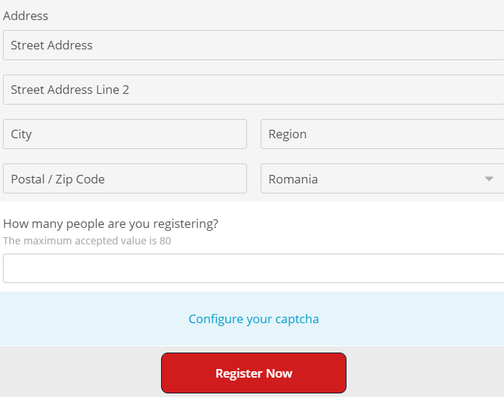
The <button> element
<button></button>

Slide 30
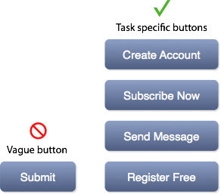
Name
Identifies the element
Announced by screen readers

Slide 31
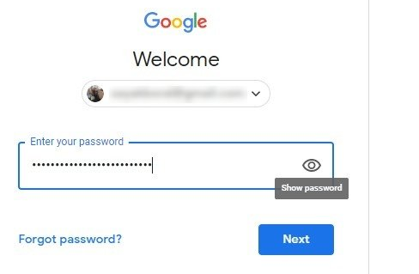
The <button> element
<button>Show password</button>

Slide 32
State
Indicates the element’s condition
Announced by screen readers

Slide 33
The aria-pressed attribute
<button aria-pressed=“true“>Show password</button>

Slide 34
Description
Optional useful information
Announced by screen readers

Slide 35
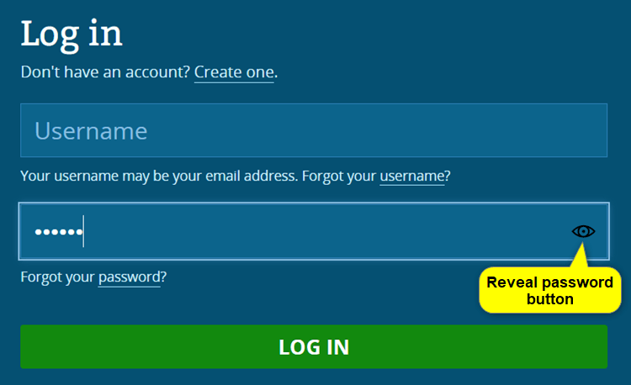
The aria-describedby attribute
<button aria-pressed=“true“ aria-describedby=“desc">Show password</button>
<p id=“desc">Reveal your password</p>

Slide 36
Headings
<h1>Tequila</h1>
…
<h2>Reposado tequila</h2>
…
<h2>Añejo tequila</h2>

Slide 37
Landmarks
<body>
<banner>…</banner>
<main>…</main>
<footer>…</footer>
</body>

Slide 38
Nav
<nav>…</nav>

Slide 39
Nav
<nav aria-label=“Website“>…</nav>

Slide 40
Lists
<ul>
<li>Role</li>
<li>Name</li>
<li>State</li>
</ul>

Slide 41
Navigation
<nav aria-label=“Website“>
<ul>
<li><a href=“/“>Home</a></li>
<li><a href=“/about/“>About</a></li>
…
</ul>
</nav>

Slide 42
Navigation
<nav aria-label=“Website“>
<ul>
<li><a aria-current=“true” href=“/“>Home</a></li>
<li><a href=“/about/“>About</a></li>
…
</ul>
</nav>

Slide 43
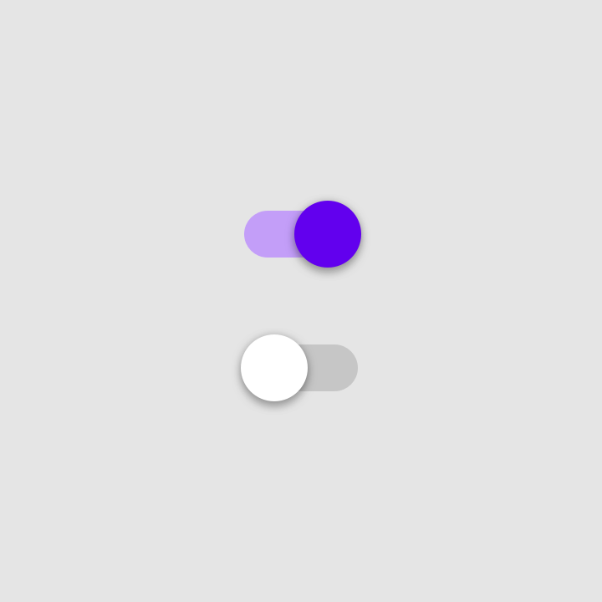
Radio buttons
<label for="r1">
<input type="radio" id="r1" name=“colour">
Purple</label>
<label for="r2">
<input type="radio" id="r2" name=“colour">
Red</label>

Slide 44
Radio groups
<fieldset>
<legend>Choose a colour</legend>
<label for="r1">
<input type="radio" id="r1" name=“colour">
Purple</label>
<label for="r2">
<input type="radio" id="r2" name=“colour">
Red</label>
</fieldset>

Slide 45
Data tables
<table>
<caption>Average daily tea and coffee consumption</caption>
<tr>
<th>Person</th><th>Coffee</th><th>Tea</th>
</tr>
<tr>
<th>Njoki</th><td>5 cups</td><td>0 cups</td>
</tr>
<tr>
<th>Iesha</th><td>1 cup</td><td>2 cups</td>
</tr>
<tr>
<th>Léonie</th><td>0 cups</td><td>25 cups</td>
</tr>
</table>

Slide 46
Data table demo

Slide 47
Modes

Slide 48
Virtual/browse mode
The screen reader intercepts keyboard commands before they reach the browser

Slide 49
Forms/focus mode
Keyboard commands are passed through to the browser

Slide 50
Forms/focus mode demo

Slide 51
Applications mode
ARIA composite roles trigger forms/focus mode automatically:
combobox
grid
listbox
menu and menubar
progressbar
radiogroup
tree and treegrid
tablist

Slide 52
Menubar: Basic HTML
<ul>
<li>
<a href="#">Categories</a>
<ul>
<li> <a href="code.html">Code things</a> </li>
<li> <a href="life.html">Web life</a> </li>
...
</ul>
</li>
...
</ul>

Slide 53
Menubar: Roles
<ul role="menubar">
<li role="none">
<a role="menuitem" href=“#">Categories</a>
<ul role="menu">
<li role="none">
<a role="menuitem" href="code.html">Code things</a>
</li>
<li role="none">
<a role="menuitem" href="life.html">Web life</a>
</li>
...

Slide 54
Menubar: Names
<ul aria-label=“Blog taxonomy">
<li role="none">
<a role="menuitem" href="#">Categories</a>
<ul role="menu" aria-label="Categories">
<li role="none">
<a role="menuitem" href="code.html">Code things</a>
</li>
<li role="none">
<a role="menuitem" href="life.html">Web life</a>
</li>
...

Slide 55
Menubar: States
<ul aria-label="Blog taxonomy">
<li role="none">
<a role="menuitem" aria-expanded="false" href="#">Categories</a>
<ul role="menu" aria-label="Categories">
<li role="none">
<a role="menuitem" href="code.html">Code things</a>
</li>
<li role="none">
<a role="menuitem" href="life.html">Web life</a>
</li>
...

Slide 56
Menubar demo

Slide 57
Keyboard commands
Enter/Space
Opens/closes the menu
Up/Down/Left/Right
Cycles through the menus
Escape
Closes the open menu and returns focus to the parent menu

Slide 58
Menubar demo

Slide 59
Thank you!
Web Directions AAA @LeonieWatson

