Slide 1
Possible With Accessibility?
PWA Summit, October 2021

Slide 2
Inherent accessibility

Slide 3
Voice in

Slide 4
Speech out

Slide 5
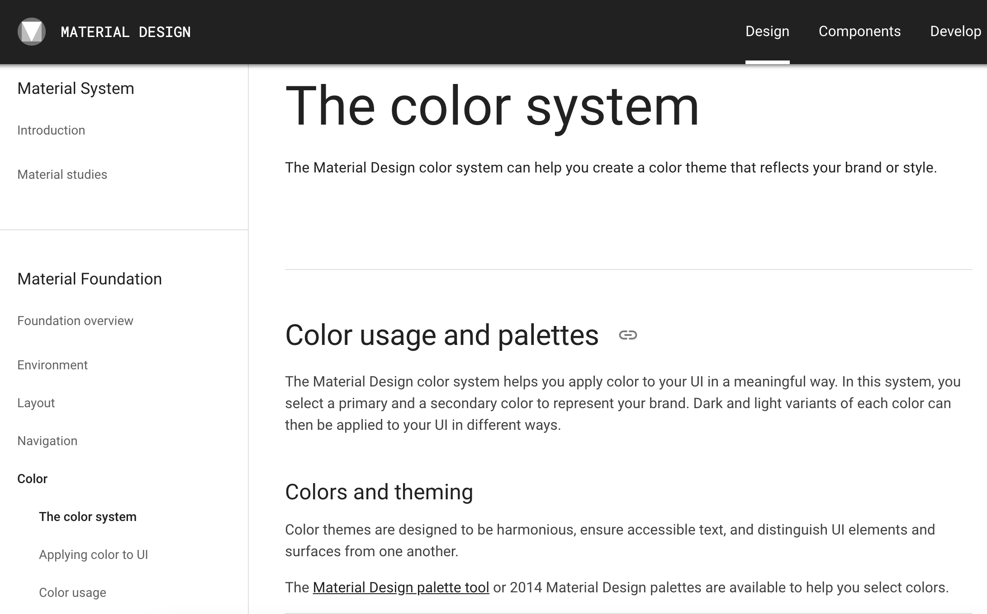
Home screen
Android Material Design

Slide 6
Icon size
48dp x 48dp = touch target of 9mm

Slide 7
Configuration
Web Application Manifest

Slide 8
name
{
“name”: “Tink.UK”
}

Slide 9
description
{
“description”: “Leonie Watson on technology, food, and life in the digital age”
}

Slide 10
lang
{
“lang”: “en-GB”
}

Slide 11
Plus ca change, plus c’est la mem chose
Accent switching

Slide 12
orientation
{
“orientation”: “any”
}

Slide 13
shortcuts
{
“name”: “Code things”,
“url”: “/category/code-things”,
“description”: “Posts in the code things category”
}

Slide 14
⚠️ user_preferences
{
"user_preferences": [{
"context": "(prefers-color-scheme: dark)",
"redefine": {
"theme_color": "#bdbdbd",
"background_color": "#000000"
}
}],
"background_color": "#fff"
}

Slide 15
Content
Inclusive Design Principles

Slide 16
Ensure your interface provides a comparable experience for all so people can accomplish tasks in a way that suits their needs without undermining the quality of the content
Provide comparable experience

Slide 17
People use your interface in different situations. Make sure your interface delivers a valuable experience to people regardless of their circumstances
Consider situation

Slide 18
Use familiar conventions and apply them consistently
Be consistent

Slide 19
Ensure people are in control; people should be able to access and interact with content in their preferred way
Give control

Slide 20
Consider providing different ways for people to complete tasks, especially those that are complex or non standard
Offer choice

Slide 21
Help users focus on core tasks, features, and information by prioritising them within the content and layout
Prioritise content

Slide 22
Consider the value of features and how they improve the experience for different users
Add value

Slide 23
Thank you!
Léonie Watson

