Slide 1
Made with love
Léonie Watson, TetraLogical

Slide 2
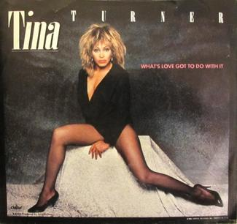
What’s love got to do with it?
Tina Turner, 1984
Notes:
Photo credit: https://en.wikipedia.org/wiki/What%27s_Love_Got_to_Do_with_It_(song)

Slide 3
Accessibility doesn’t happen by accident
Notes:
Accessibility takes thought, understanding, and a little bit of love.
Photo credit: https://www.builddirect.com/blog/how-to-clean-up-a-paint-spill/

Slide 4
Everybody needs somebody to love
The Blues Brothers, 1980
Notes:
Photo credit: https://www.discogs.com/The-Blues-Brothers-Everybody-Needs-Somebody-To-Love-Think/release/1020317

Slide 5
You
Notes:
Design for your future self, the person you will be in 20, 30, 40 years time, when you may not be able to see, hear, move, or think as easily as you do now.
Photo credit: Getty images https://www.istockphoto.com/vector/seamless-banner-with-a-diverse-crowd-of-people-gm1094258440-293681330

Slide 6
Me
Notes:
Design for people who have permanent disabilities, including people who are blind or have low vision, people who are deaf or hard of hearing, people with physical disabilities or mobility difficulties, and people with cognitive disabilities that affect things like learning, processing, and remembering.
Photo credit: Disability Rights UK https://www.disabilityrightsuk.org/news/2015/december/worlds-most-famous-disabled-people

Slide 7
Them, everybody
Notes:
Design for people with permanent, temporary, and situational disabilities – all of us really.

Slide 8
I’ll do anything for love (but I won’t do that)
Meatloaf, 1993
Notes:
Photo credit: https://en.wikipedia.org/wiki/I%27d_Do_Anything_for_Love_(But_I_Won%27t_Do_That)

Slide 9
Accessibility stops creativity
Notes:
People say accessibility is boring, limiting, or ugly.
Photo credit: Lewis Liu https://www.shutterstock.com/image-photo/love-locks-on-arts-bridge-paris-303162452

Slide 10
Ernest Hemingway
“For sale, baby shoes, never worn”
Notes:
Ernest Hemingway was supposed to have won a bet by writing a story in six words, that had all the resonance and depth of his novels.
The story is apocryphal with regard to Ernest Hemingway, but variations of this six word story can be dated as early as 1906.
Photo credit: https://imgur.com/gallery/pdBV5Ns

Slide 11
Michelangelo
Notes:
The statue of David was started in 1463 by Agostino Di Duccio, then taken up by Michelangelo 40 years later – with very specific constraints about the way David should be positioned, and when the statue should be completed.
Photo credit: https://simple.wikipedia.org/wiki/David_(Michelangelo)

Slide 12
GOV.UK
Notes:
In 2013, GOV.UK, the website of the UK central government, won the prestigious Design of the Year award, beating 98 other entries.

Slide 13
Accessibility is difficult
Notes:
People say accessibility takes too much time, it’s too difficult, it can’t be done.
Photo credit: https://www.geo.university/pages/blog?p=rocket-science-it-s-not-that-hard

Slide 14
Tying your shoelaces
Notes:
Tying your shoelaces was difficult once upon a time, but you managed it.
Photo credit: brennaval/flickr/CC BY-NC-ND 2.0, https://creativecommons.org/licenses/by-nc-nd/2.0/

Slide 15
Cooking Sunday roast
Notes:
Cooking Sunday roast is difficult, until the preparation and timing becomes second nature.
Photo credit: https://www.fullers.co.uk/pubs/pub-finder/sunday-roast

Slide 16
Using technology
Notes:
Learning to use technology is difficult at first, learning to design and develop products and services that other people will use, even more so.

Slide 17
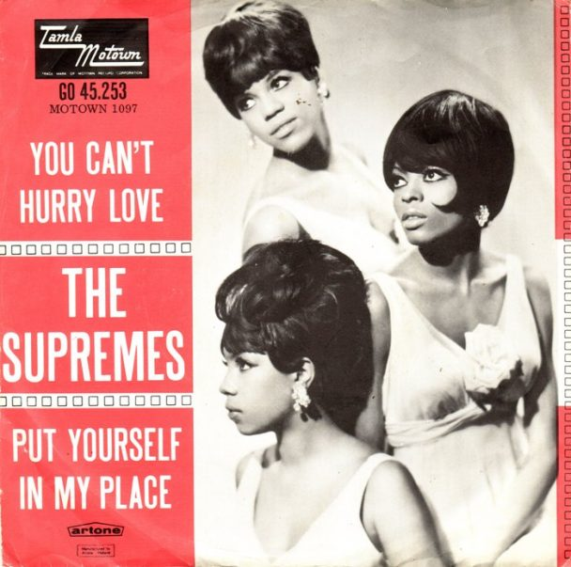
You can’t hurry love
The Supremes, 1966
Notes:
Photo credit: https://www.udiscovermusic.com/stories/supremes-you-cant-hurry-love-song/

Slide 18
Requirements
Accessibility must be a requirement for every project
👣

Slide 19
User research
Consider the needs of people who use technology in different ways to you
👣
👣

Slide 20
Personas
Incorporate disabilities into the personas you use
👣
👣

Slide 21
Design
Consider the needs of people who see differently, or do not see at all
👣
👣
👣

Slide 22
Topography
Choose simple fonts with characters that are distinct from each other
👣
👣
👣

Slide 23
Text size
Choose a default text size that is comfortable for everyone to read
👣
👣
👣

Slide 24
Colour palettes
Choose a colour palette that makes good colour contrast achievable
👣
👣
👣

Slide 25
Layout
Create layouts that are simple, uncluttered, and consistent
👣
👣
👣

Slide 26
Interaction
Consider the needs of people who interact with technology in different ways
👣
👣
👣
👣

Slide 27
Target size
Make interactive controls generous in size
👣
👣
👣
👣

Slide 28
Action buttons
Include action buttons for forms
👣
👣
👣
👣

Slide 29
Labels and instructions
Provide visible form labels and helpful instructions
👣
👣
👣
👣

Slide 30
Production
Consider the way assistive technologies depend on the choices you make
👣
👣
👣
👣
👣

Slide 31
HTML elements
Use appropriate HTML elements whenever possible, and polyfill accessibility when you cannot
👣
👣
👣
👣
👣

Slide 32
Usability testing
Include people with disabilities when you do usability testing
👣
👣
👣
👣
👣

Slide 33
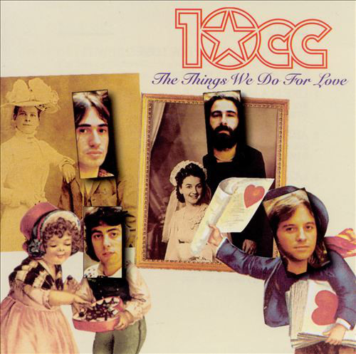
The things we do for love
10CC, 1977
Notes:
Photo credit: https://www.discogs.com/10cc-The-Things-We-Do-For-Love/release/7889600

Slide 34
InclusiveDesignPrinciples.org

Slide 35
Provide comparable experience
Ensure your interface provides a comparable experience for all so people can accomplish tasks in a way that suits their needs without undermining the quality of the content

Slide 36
Text descriptions
Notes:
A text description could just say “Some old gate”, but it wouldn’t describe the same experience as a text description like “…”.
Photo credit: https://en.wikipedia.org/wiki/Hole-in-the-Wall_%28Eastern_Cape%29#/media/File:Kristenmarie82.Gat-in-die-muur,_Koffiebaai.2.jpg

Slide 37
Consider situation
People use your interface in different situations. Make sure your interface delivers a valuable experience to people regardless of their circumstances

Slide 38
Colour contrast
Notes:
Photo credit: Credit: Getty Images / Anna Wolska-Rzewuska

Slide 39
Be consistent
Use familiar conventions and apply them consistently

Slide 40
Design patterns
Notes:
Photo credit: https://en.wikipedia.org/wiki/Blueprint#/media/File:Joy_Oil_gas_station_blueprints.jpg

Slide 41
Give control
Ensure people are in control - people should be able to access and interact with content in their preferred way

Slide 42
Scroll control
Notes:
'Infinite scrolling' can be problematic, especially for users navigating by keyboard because they can't get past the stream of refreshing
content. Give the option to turn off this feature and replace it with a 'load more' button.
Photo credit: https://mindmatters.ai/2021/01/the-infinity-mirror-trap-part-2-the-thought-determinism-paradox/

Slide 43
Offer choice
Consider providing different ways for people to complete tasks, especially those that are complex or non standard

Slide 44
Multiple ways

Slide 45
Prioritise content
Help users focus on core tasks, features, and information by prioritising them within the content and layout

Slide 46
One thing at a time

Slide 47
Add value
Consider the value of features and how they improve the experience for different users

Slide 48
Do the hard work
Notes:
Photo credit: Ralf Geithe/Shutterstock

Slide 49
Greatest love of all
Whitney Houston, 1986
Notes:
Photo credit: https://soundcloud.com/djalexandremaes/whitney-houston-greatest-love-of-all-dj-ale-maes-emotional-mash

Slide 50
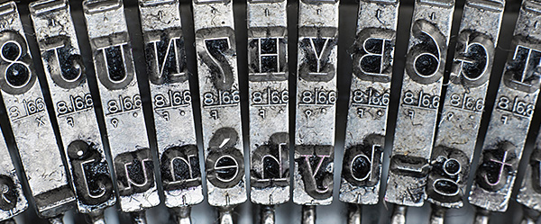
Make it with love
Notes:
Don’t think of accessibility as a challenge to creativity, think of it as a creative challenge – one you can meet with ingenuity, energy, and a little bit of love for what you do and the people you do it for!
The typewriter, one of the most widely know accessibility aids, was made with love. It was invented by the Italian, Pellegrino Turri, as a means to communicate with his blind lover (or sister depending on what account you read), who was unable to write with pen and ink.
Photo credit: Photo credit: https://www.utilize.co.uk/blog/the-modern-typewriter-was-invented-as-a-disability-aid

Slide 51
Thank you!
Léonie Watson, TetraLogical
Twitter: @LeonieWatson
Email: lwatson@tetralogical.com

